Slide 1
Word Wealth Unit 3
Adjectives Only

Slide 2
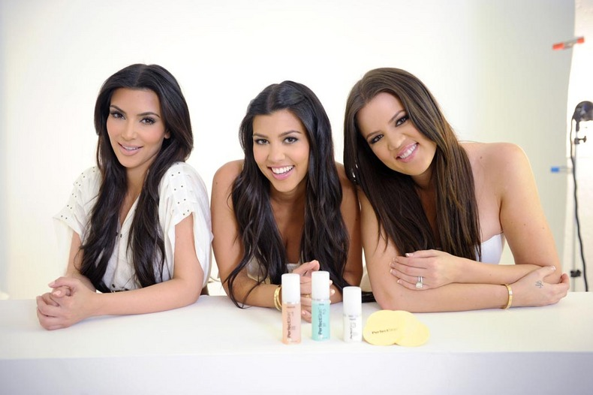
Brusque
Abrupt, blunt, curt
Related Words:
Tactless- lacking in skill or grace when dealing with others
Surly- rude, blunt in an unkind way
Blatant- disagreeably loud or noisy

Slide 3
Candid
Frank, honest, truthful

Slide 4
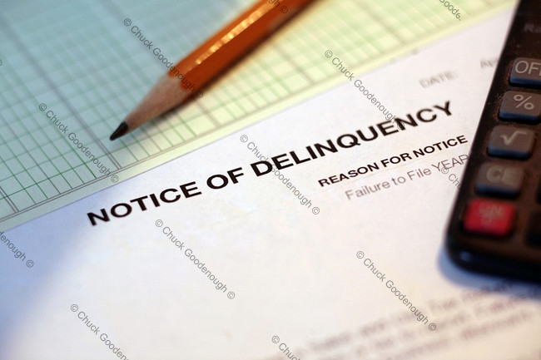
Delinquent
Wanting, failing, overdue

Slide 5
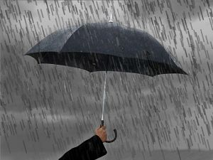
Dour
Sullen, gloomy, sour
Related Words:
Dismal- used to describe places or scenes that are gloomy, cheerless, woeful
Melancholy- brooding, sadly thoughtful

Slide 6
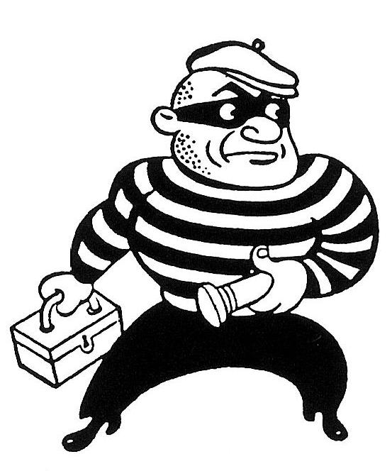
Furtive
Sly, stealthy
Synonym- Surreptitious- stresses secretiveness

Slide 7
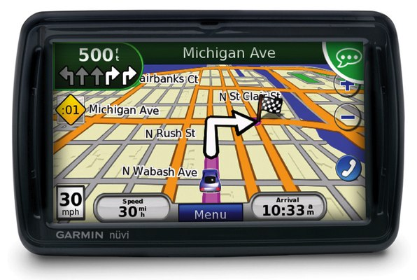
Lucid
Clear in (and to) the mind
Related Word:
Coherent- holds or sticks together well, thus achieving clearness (speech or explanation)

Slide 8
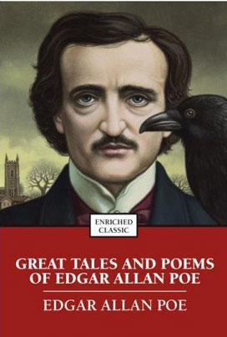
Macabre
Grim, gruesome, death-haunted
Related Words:
Weird- eerie
Ghastly- shocking or ghostly
Gruesome- sickening, unappetizing, loathsome
Grisly- revolting and nauseating (stronger than gruesome)

Slide 9
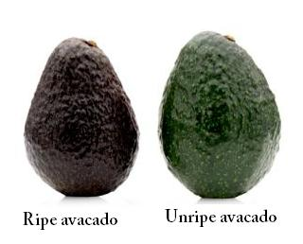
Mature
Ripe, fully developed

Slide 10
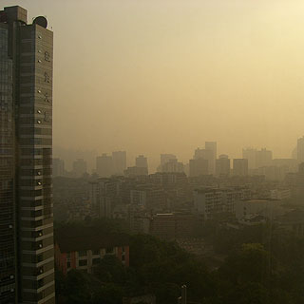
Nebulous
Vague, hazy, indefinite

Slide 11
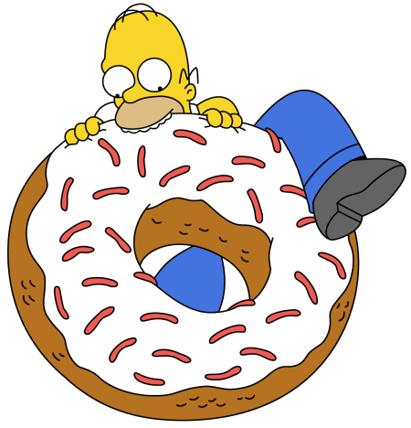
Obese
Fat, stout, corpulent

Slide 12
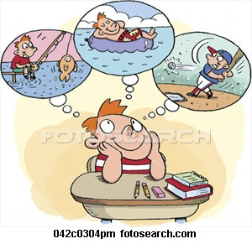
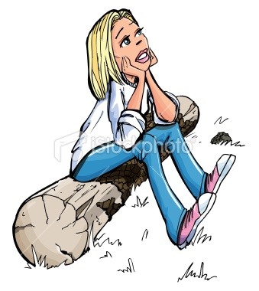
Pensive
Deeply thoughtful, wistful
Related Words:
Wistfulness- sadder than pensiveness
Reverie- a state of daydreaming

Slide 13
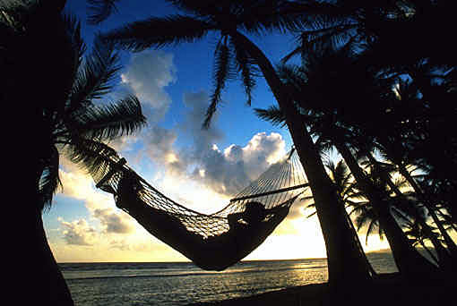
Placid
Calm, serene, unruffled
Related Words:
Tranquil- same
Demure- a person who is reserved and modest
Imperturbable- calm and very difficult to stir up
Stoical- a willful indifference to pain or pleasure

Slide 14
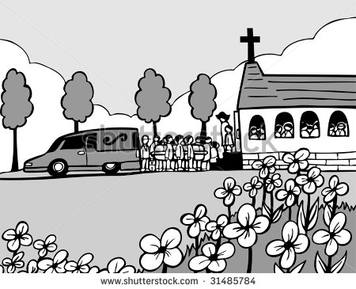
Plaintive
Sad, mournful

Slide 15
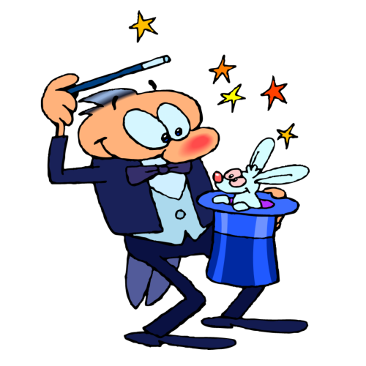
Plausible
Appearing true or reasonable
Antonyms:
Implausible, incredible, unbelievable

Slide 16
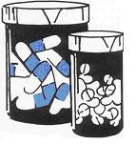
Potent
Powerful, very effective

Slide 17
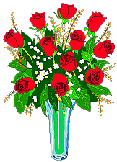
Pungent
Sharp, stinging, keen
Related Word:
Aromatic-an odor that is sweet, spicy, fragrant

Slide 18
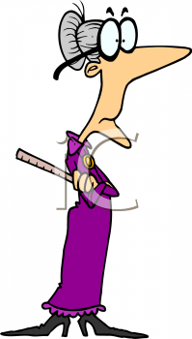
Rigorous
Rigidly severe, exacting
Related Words:
Rigid- stiff, unbending
Austere- harsh, stern, sever in habits or discipline
Scrupulous- exact in following the rules (due to ethics)

Slide 19
Wanton
Senseless, malicious, reckless
Antonyms:
Discrete, cautious, judicious, responsible

Slide 20
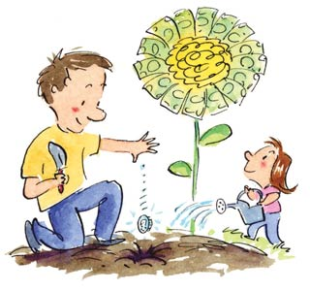
Wary
Cautious, watchful (in facing danger)
Related Word:
Chary- to be frugal or cautious in giving

Slide 21
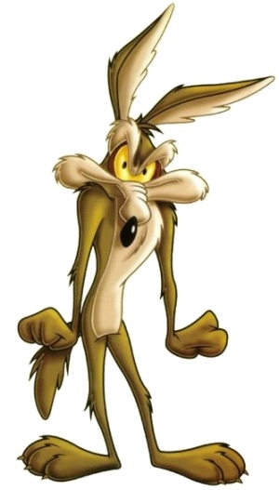
Wily
Crafty, cunning

